Slide 1
BUSINESS INTELLIGENCE 381 G. Mudare
Notes:
Introduce yourself to the students and also find out there names
Have them give you in 30 seconds a summary of who they are and what there interest in IT is

Slide 2
Power BI Introduction

Slide 3
Introduction
Business decision makers depend on an accurate story to drive better business decisions.
The faster a business can make precise decisions, the more competitive they will be and the better advantage they will have.
The underlying challenge that businesses face today is understanding and using their data in such a way that impacts their business and ultimately their bottom line.
Data analysis exists to help overcome these challenges and pain points, ultimately assisting businesses in finding insights and uncovering hidden value in troves of data through storytelling.

Slide 4
Overview of data analysis
Data analysis is the process of identifying, cleaning, transforming, and modeling data to discover meaningful and useful information.
Data is then crafted into a story through reports for analysis to support the critical decision-making process.
Data analytics are divided into the following 5 categories:
Descriptive
Diagnostic
Predictive
Prescriptive
Cognitive

Slide 5
Categories of Data Analytics
Descriptive analytics - help answer questions about what has happened based on historical data.
can help track the success or failure of key objectives e.g., sales reports
Diagnostic analytics - help answer questions about why events happened
supplement basic descriptive analytics to discover the cause of these events/anomalies e.g., unexpected changes in a metric or a particular market.
Predictive analytics - help answer questions about what will happen in the future.
use historical data to identify trends and determine if they're likely to recur.
Prescriptive analytics - help answer questions about which actions should be taken to achieve a goal or target.
allows businesses to make informed decisions in the face of uncertainty.
Cognitive analytics - attempt to draw inferences from existing data and patterns, derive conclusions based on existing knowledge bases, and then add these findings back into the knowledge base for future inferences, a self-learning feedback loop.

Slide 6
Categories of Data Analytics (Example)
By enabling reporting and data visualizations, a retail business uses descriptive analytics to look at patterns of purchases from previous years to determine what products might be popular next year (predictive).
The company might also look at supporting data to understand why a particular product was popular and if that trend is continuing (diagnostic) , which will help them determine whether to continue stocking that product (prescriptive).
Then, they can use this analysis to determine whether certain marketing efforts or online social activities contributed to the sales increase (cognitive) .

Slide 7
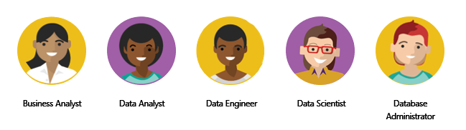
Roles in data
Data analytics applications and projects often involves the use of skills and knowledge from numerous individuals.
Some roles overlap
operational aspects of data environment – availability, performance, optimization
closer to the business - interpreting data
profiling, cleaning, and transforming data, modelling reporting.
manage data platforms -ingest, egress, and transform data from multiple sources.
use machine learning to perform advanced analytics.

Slide 8
The Power BI Product
Microsoft Power BI is a collection of software services, apps, and connectors that work together to turn your unrelated sources of data into coherent, visually immersive, and interactive insights.
Microsoft Power BI is not a single tool, but a set of tools.
The business intelligence (BI) process (Larson, 2020)

Slide 9
The Power BI Product
Microsoft Power BI consists of three parts:
Power BI Desktop,
the Power BI service
Power BI mobile apps.

Slide 10
Power BI Desktop
Power BI Desktop is where you
Connect with your data
set up transformation rules;
Perform data wrangling operations,
Massage the data into the format that your reports require;
Build your reports.

Slide 11
The Power BI Service
The Power BI service is the cloud‐based product where collaboration and
sharing take place.
can also create reports and dashboards within the
Power BI service, once you have created and shared content.

Slide 12
Power BI Mobile Apps
Power BI mobile apps can be used to consume that content. Apps are available
for every major mobile platform; so, it is very easy to ensure that your colleagues are kept up‐to‐date with the latest reports when on the move.

Slide 13
Microsoft Power BI
A collection of :
Software services,
Apps,
Connectors
These work together to turn unrelated sources of data into coherent, and interactive insights.
Data:
Microsoft Excel workbooks,
collection of cloud-based
on-premise hybrid data warehouses

Slide 14
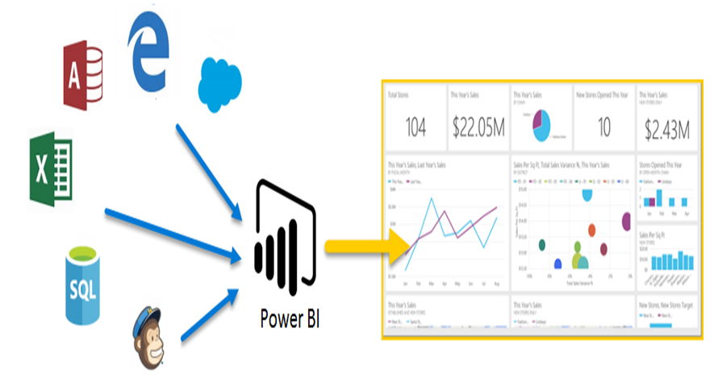
Microsoft Power BI

Slide 15
Capabilities of Ms Power BI
Creating quick insights from an Excel workbook or a local database.
Extensive modelling and real-time analytics
Custom development
Serve as the analytics and decision engine behind group projects, divisions, or entire corporations.

Slide 16
How Power BI matches Different Roles
Use of Power BI depends on which feature or service of Power BI is the best tool for a given situation
Different roles might use Power BI differently:
View reports and dashboards in the Power BI service
Use Power BI Desktop to publish Power BI Desktop reports to the Power BI service
Use Power BI phone app to monitor progress

Slide 17
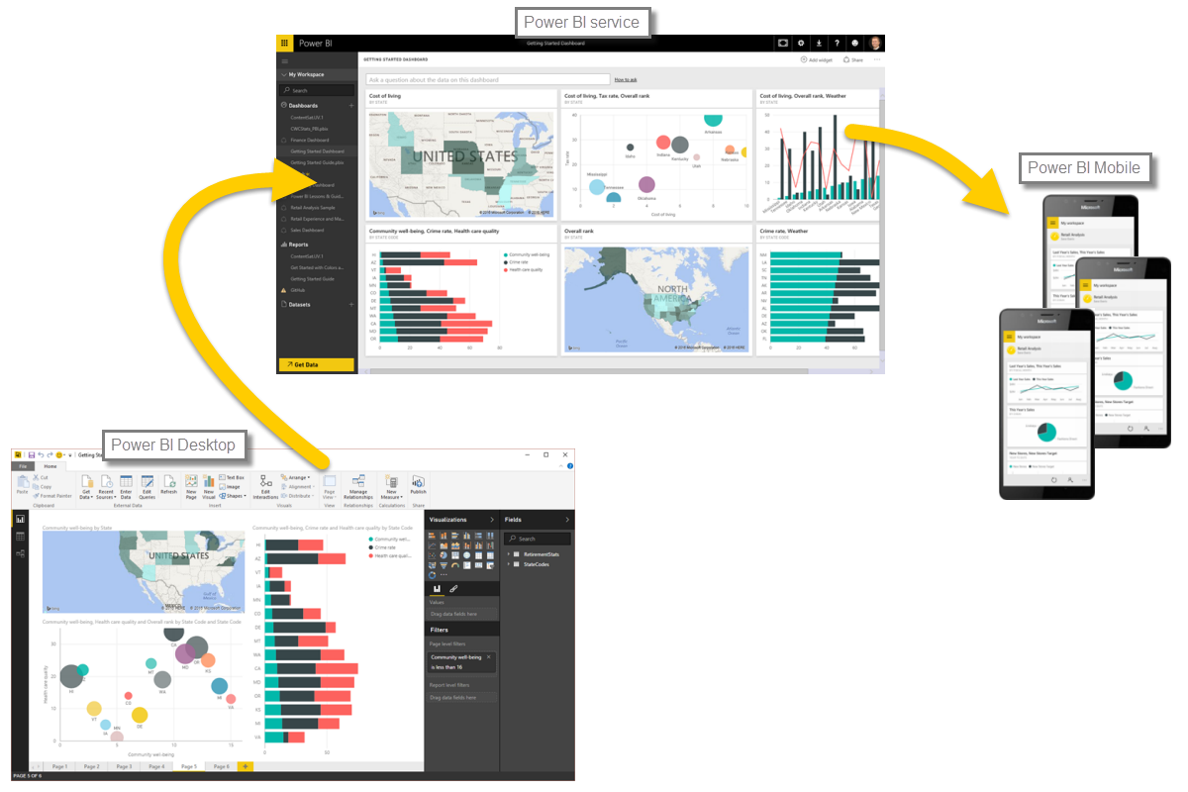
The flow of work in Power BI
A common flow of work in Power BI begins in Power BI Desktop, where
a report is created.
report is then published to the Power BI service
report is shared, so that users of Power BI Mobile apps can consume the information.

Slide 18
Building blocks of Power BI
Basic building blocks in Power BI:
Visualizations
Datasets
Reports
Dashboards
Tiles

Slide 19
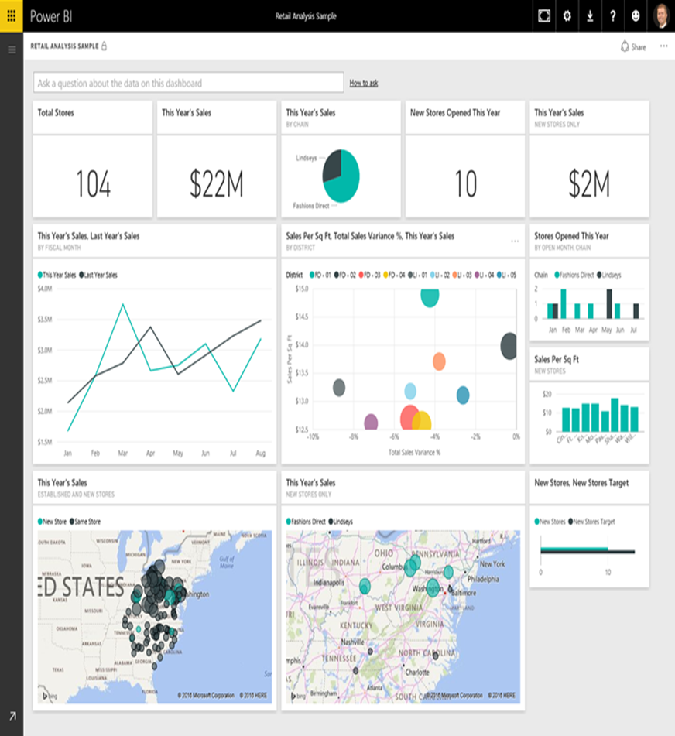
Visualizations
A visualization (sometimes also referred to as a visual) is a visual representation of data
charts, or color-coded maps

Slide 20
Datasets
A dataset is a collection of data that Power BI uses to create its visualizations.
Range from simple dataset that's based on a single table from a Microsoft Excel to combination of many different sources, which you can filter and combine to provide a unique collection of data (a dataset) for use in Power BI.

Slide 21
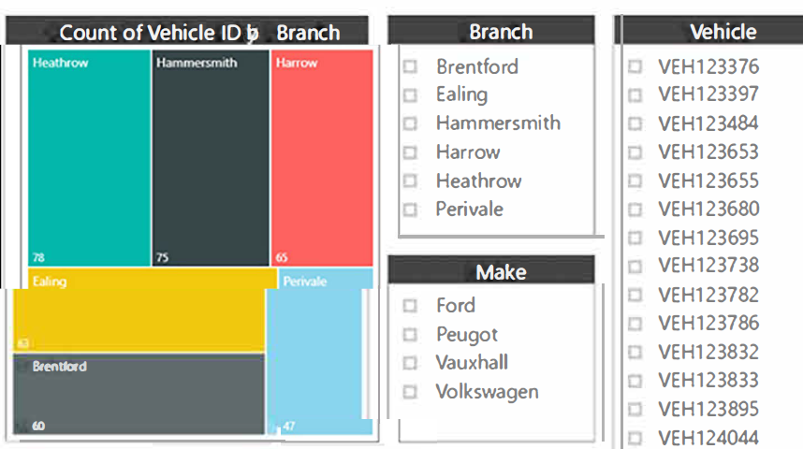
Reports
A report is a collection of visualizations that appear together on one or more pages.
A report in Power BI is a collection of items that are related to each other
Reports let you create many visualizations, on multiple pages if necessary, and let you arrange those visualization in whatever way that best tells your story.

Slide 22
Dashboards
A Power BI dashboard is a collection of visuals from a single page that you can share with others
A selected group of visuals that provide quick insight into the data or story you're trying to present.
A dashboard must fit on a single page, often called a canvas

Slide 23
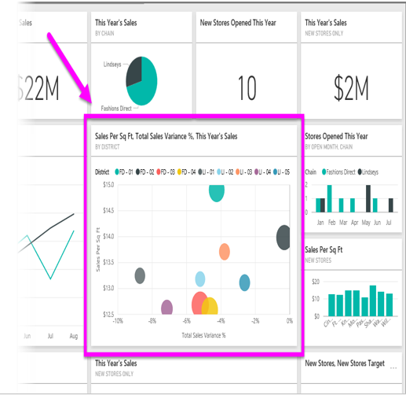
Tiles
When you're creating a report or a dashboard in Power BI, you can move or arrange tiles the way you want.
A tile is a single visualization on a report or a dashboard.
It's the rectangular box that holds an individual visual.

Slide 24

App
An app is a collection of preset, ready-made visuals and reports that are shared with an entire organization

Slide 25
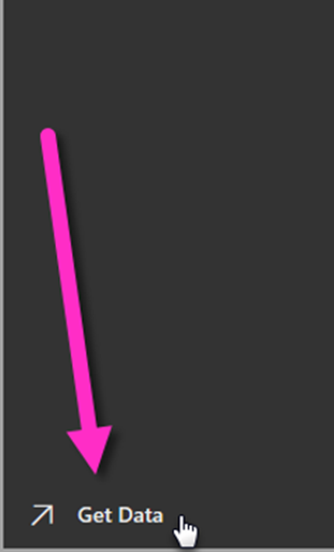
Create dashboards with cloud services
From the Power BI service, you can just select the Get Data button in the lower-left corner of the home page

Slide 26
Create dashboards with cloud services
The canvas (the area in the center of the Power BI service) shows you the available sources of data in the Power BI service.

Slide 27
Overview of Power BI Desktop
Power BI Desktop is a tool to connect to, clean, and visualize your data
With Power BI Desktop, you can connect to data and then model and visualize it in different ways

Slide 28
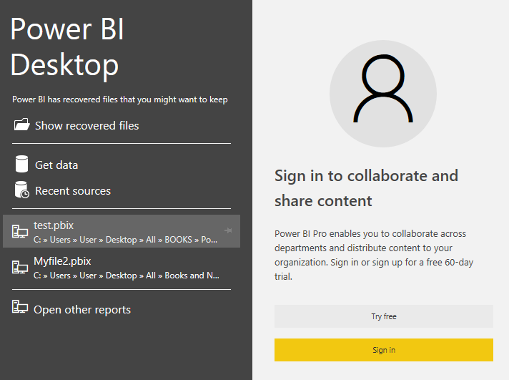
Getting started with Power BI Desktop
Start in Power BI Desktop, and select Get Data

Slide 29
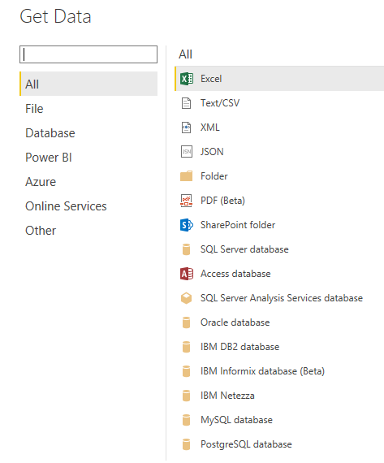
Getting started with Power BI Desktop
Regardless of which
Data source you choose, Power BI connects to that data source, and shows you the data available
from that source

Slide 30
Report
The Report view has five main areas:
The ribbon, which displays common tasks associated with reports and visualizations
The Report view, or canvas, where visualizations are created and arranged
The Pages tab area along the bottom, which lets you select or add a report page
The Visualizations pane, where you can change visualizations, customize colors or axes, apply filters, drag fields, and more
The Fields pane, where query elements and filters can be dragged onto the Report view, or dragged to the Filters area of the Visualizations pane

Slide 31
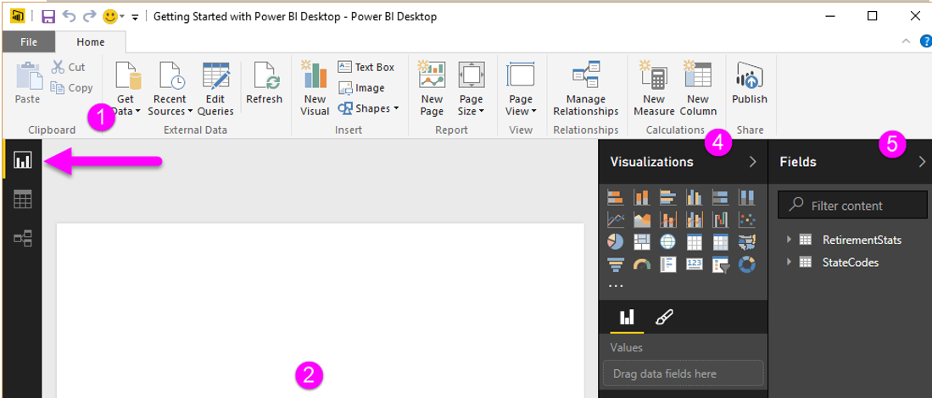
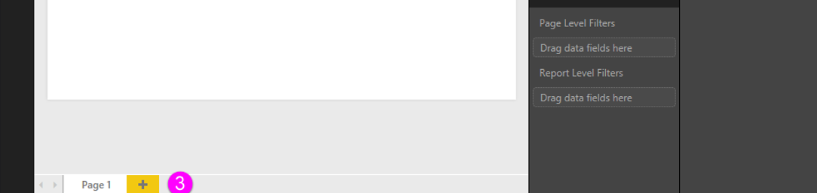
Report
The ribbon, which displays common tasks
associated with reports and visualizations
The Report view, or canvas,
where visualizations are
created and arranged
Fields pane, where query elements and filters can be dragged onto the Report
Pages tab

Slide 32
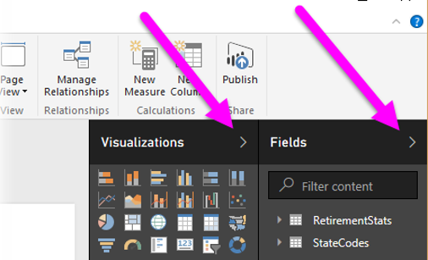
Report
The Visualizations and Fields pane can be collapsed by selecting the small arrow along the edge, providing more space in the Report view to build cool visualizations

Slide 33
Report
To create a visualization, drag a field from the Fields list onto the Report view
In this case, let’s drag the State field from ProductID, and Orderqty and see what happens.

Slide 34
Connect to data sources in Power BI Desktop
Power BI Desktop can connect to a whole range of data sources, including on-premises databases, Excel workbooks, and cloud service
You can connect to generic sources through XML, CSV, text, and ODBC.
In Power BI Desktop, there are all sorts of different data sources available. Select a source to establish a connection.
Depending on your selection, you will be asked to find the source on your computer or network, or be prompted to sign in to a service to authenticate your request.
After connecting, the first window you'll see is the Navigator which displays the tables or entities of your data source, and clicking on one gives you a preview of its contents.
Import your selected tables or entities immediately, or select Edit to transform and clean your data before importing.

Slide 35
Connect to data sources in Power BI Desktop
Once you've selected the tables you'd like to bring into Power BI Desktop, you can choose to load them into Power BI Desktop by selecting the Load button

Slide 36
Clean and transform your data with the Query Editor
Power BI Desktop includes Query Editor, a powerful tool for shaping and transforming data so it's ready for your models and visualizations.
Select Edit from Navigator,
You can also launch Query Editor directly from Power BI Desktop, using the Edit Queries button on the Home ribbon.

Slide 37
Clean and transform your data with the Query Editor
Once Query Editor is loaded with data that's ready for you to shape, you see a handful of sections:
In the ribbon, many buttons are now active to interact with the data in the query
In the left pane, queries (one for each table, or entity) are listed and available for selection, viewing, and shaping
In the center pane, data from the selected query is displayed and available for shaping
The Query Settings window appears, listing the query’s properties and applied steps

Slide 38
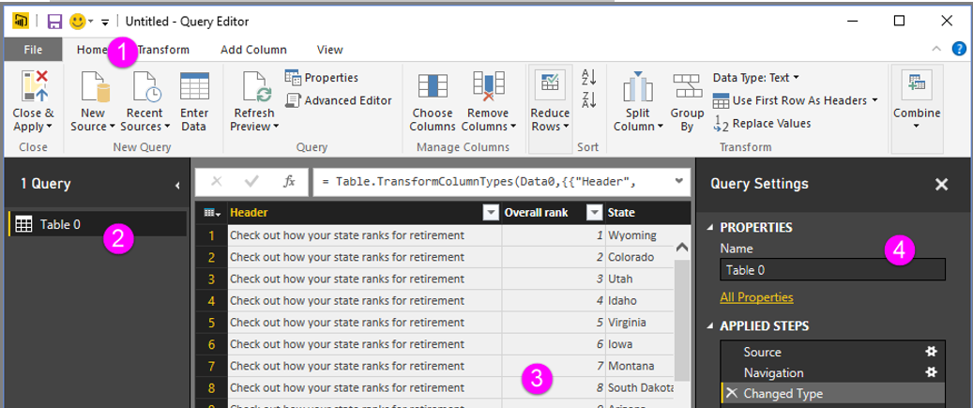
Clean and transform your data with the Query Editor

Slide 39
Clean and transform your data with the Query Editor
In the center pane, right-clicking on a column displays a number of different available transformations
The Query Editor ribbon contains additional tools, such as changing the data type of columns, adding scientific notation, or extracting elements from dates, such as day of the week.

Slide 40
Lab exercise
Open the Power BI project named Sales Analysis. You will find it in the Practice folder.
Explore the PowerBI Desktop interface
Using the Financials sample dataset provided in PowerBI create a report like the one shown on the next Page
Feel free to add more visuals and make your report more appealing

Slide 41
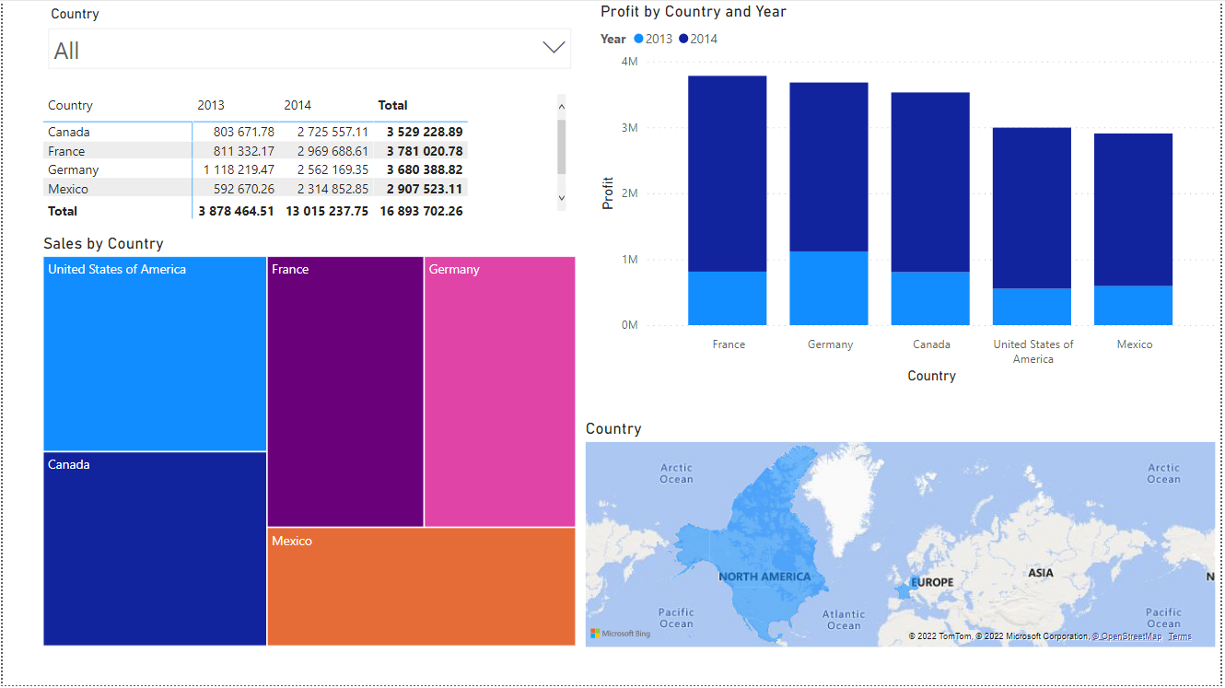
Lab exercise

Slide 42
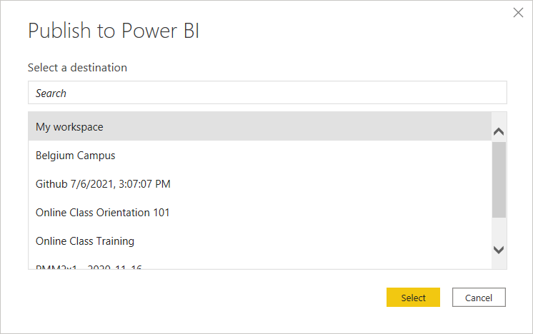
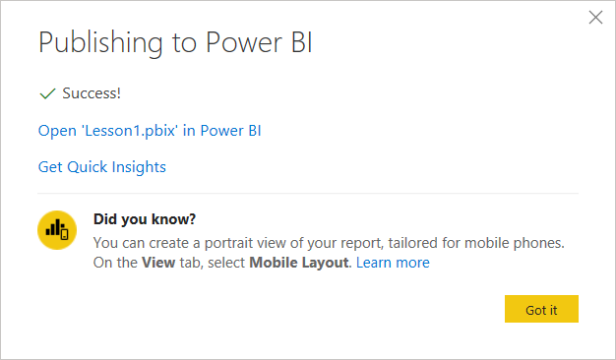
Lab exercise
Publish your report to the Power BI service.
Click Publish on the Home ribbon or on File Menu
Note: you will need a Power BI service account (you can use your school account if you already have access to Microsoft services e.g. Office 365)
Choose a Destination
Open the report in the Power BI service using the link provided on the dialog
Explore your report in Power BI service

